Slide 1



End-to-End Intelligent Vision System for Automated Product Assembly, Defect Detection, and Segregation
Sridarshan A · Adhavan M · Sivapiriyan A R · Hariharasudhan D
Vishwakarma Application ID: VK26-IITI-AHM-0093
Notes:
Introduce Team Cipher Core from Sri Ramakrishna Engineering College and the project in one sentence: a low-cost PLC + Raspberry Pi vision cell that assembles, inspects and sorts tap-cap assemblies.

Slide 2

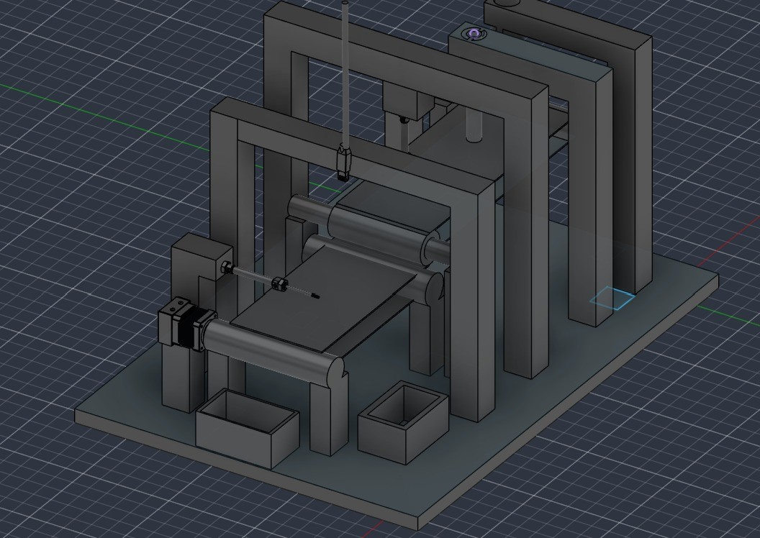
Project Overview
TEAM CIPHER CORE | SREC
5 Stations
4 Cylinders
24 V DC
4 Checks
INLINE PROCESS STAGES
PNEUMATIC ACTUATORS
PLC-CONTROLLED CELL
AUTOMATED VISION TESTS
Project Overview
Title: End-to-End Intelligent Vision System for Automated Product Assembly, Defect Detection, and Segregation
Team: Sridarshan A, Adhavan M, Sivapiriyan A R, Hariharasudhan, D
Institute: Sri Ramakrishna Engineering College
Team ID: VK26-IITI-AHM-0093 Track: Industrial Automation & Machine Vision
Core innovation: A low-cost PLC + Raspberry Pi vision cell that presses, inspects and sorts parts on the fly no proprietary smart camera needed.
Figure: 3D CAD view of the Cipher Core cell
2 / 18
Notes:
Open with the one-line innovation: affordable, open-source industrial automation for MSMEs. Point to the four numbers: five stations, four cylinders, 24 V PLC control, four automated vision checks.

Slide 3
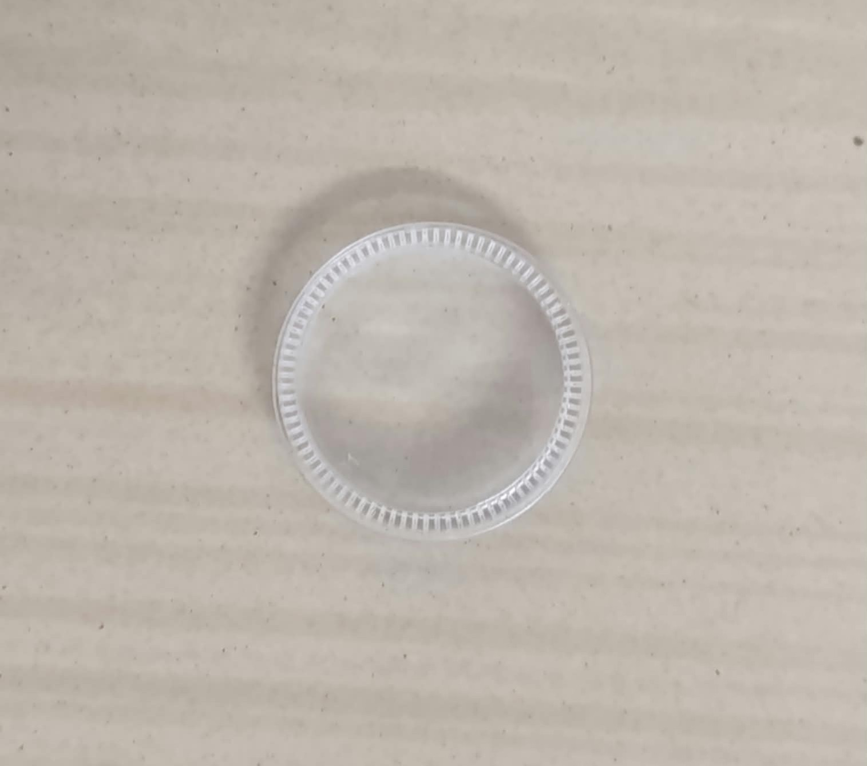
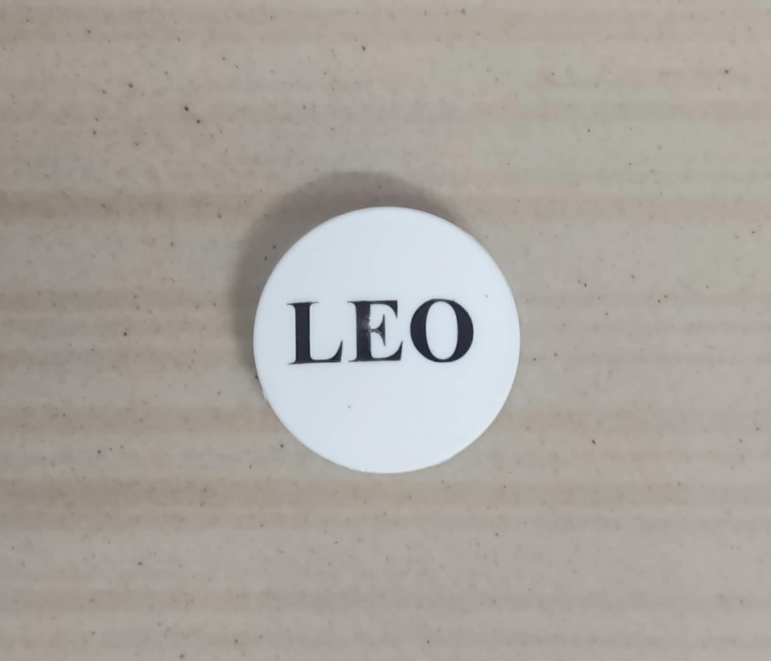
Problem Statement & Target Beneficiary
TEAM CIPHER CORE | SREC
Problem Statement
Pain point: Local units rely on manual assembly, pressing and visual quality control.
Impact: Fatigue, uneven pressing force and subjective checks let text smudges, scratches and improper mating gaps pass.
Gap: Industrial smart cameras and PLC vision systems exist, but their cost and locked-in proprietary software put them out of reach for MSMEs.
Component 1: base cap
Component 2: "LEO" top cap
Target Beneficiary
Local neighbourhood manufacturing units, MSMEs and regional assembly workshops.
Fatigue & inconsistent force
Hand pressing varies from part to part and operator to operator.
Subjective inspection
Eyes miss smudged letters, scratches and hairline gaps.
Cost & vendor lock-in
Proprietary vision systems are unaffordable for small workshops.
3 / 18
Notes:
Explain the two parts being assembled (clear base cap + white LEO-labelled top). The problem is manual pressing and eyeball inspection, and the fact that industrial vision systems are out of reach for small units.

Slide 4
User Journey: Before vs After
BEFORE: Manual workflow
AFTER: Cipher Core automated cell
1
Operator places cover and label by hand
Slow, tiring loading step
1
Feeders drop parts; cylinder presses
Consistent pneumatic mating force
2
Pressed by hand, then turned over
Inconsistent force and ergonomic strain
2
C-bend flips the assembly 180°
Zero-energy, hands-free reorientation
AUTOMATE
3
Manual inspection of text and seams
Fatigue misses smudges and hairline gaps
3
Pi vision inspects every part
Objective, high-speed text and scratch check
4
Operator sorts good and bad components
Creates a bottleneck and slows output
4
Diverter ejects defects on the fly
Conveyor never stops
Outcome: hands-free assembly, objective inspection and zero-downtime sorting – fewer defects escaping, less rework, less operator fatigue.
4 / 18
Notes:
Walk row by row: each manual step on the left is replaced by an automated step on the right. The cell removes hand pressing, eyeball inspection and manual sorting.

Slide 5
Quantified Efficiency: How We Will Benchmark
Parameter | Manual process (before) | Cipher Core cell (after) | How we validate
Pressing force | Varies by operator and fatigue | Regulated pneumatic cylinder, fixed stroke | Gap / seating consistency over a batch
Inspection | Subjective, fatigue-prone eyeballing | Image subtraction + edge detection on every part | Detection rate on seeded-defect samples
Sorting | Manual; interrupts the flow | On-the-fly diverter; conveyor keeps moving | Rejects diverted with no conveyor stop
Operator involvement | Continuous handling and checking | Load feeders, empty bins | Manual touchpoints per part
Inspection cost | Proprietary smart camera + licences | Raspberry Pi + open-source OpenCV | BOM cost vs a commercial vision unit
Metrics tracked in Phase 5 testing: cycle time per part, defect-detection rate, false-reject rate and manual touchpoints – compared against the manual baseline.
5 / 18
Notes:
Be clear that these are the measurable improvements. Baselines and results will be logged during integrated cell testing in Month 4.

Slide 6
System Architecture: Block Diagram
1 Base Feeding
2 Mating & Pressing
3 C-Bend 180° Flip
4 Pi Vision Inspection
5 Pneumatic Sorting
Mechanical Structure
Actuation & Power
Electronic Controllers
Firmware & Logic
T-slot aluminum frame
Two gravity feeders + optical sensors
Conveyor and passive C-bend
Adjustable camera arch
4 double-acting cylinders
5/2 solenoid valves on one manifold
Press and diverter cylinders
24 V DC supply, conveyor drives
Delta PLC, 24 V DC I/O
Raspberry Pi 4 + Pi Camera (CSI)
Optocoupler isolation boards
DIN-rail control cabinet
OpenCV: image subtraction + edges
Pi outputs OK / NOT OK on GPIO
Ladder: latching, timers, counters
NC fail-safe interlocks
SIGNAL PATH: FROM VISION RESULT TO PNEUMATIC ACTION
Pi Camera (CSI)
Raspberry Pi (OpenCV)
GPIO 3.3 V
Optocoupler
PLC input
Solenoid + diverter
6 / 18
Notes:
Top row is the physical process. The four cards are the subsystems. The bottom chain shows how a vision decision becomes a pneumatic action.

Slide 7
Target Specifications & Hardware Selection
TEAM CIPHER CORE | SREC
Parameter | Target Spec | Selected Hardware / Protocol
Process | 5-station inline cycle: feed, press, flip, inspect, sort | Two gravity feeders with optical stack sensors; linear conveyor; passive C-type bend
Actuation | 4 double-acting cylinders, 25 mm × 50 mm | 5/2-way solenoid valves on a central manifold; 10 bar supply
Control | 24 V DC logic with latched, fail-safe operation | Delta PLC, WPLSoft ladder program; NC stop and interlock contacts
Vision | 4 checks per part: LEO text, smudges, scratches, air gap | Raspberry Pi 4 + Pi Camera (CSI), white LED lighting, OpenCV
Interface | Safe 3.3 V to 24 V signal transfer | Optocoupler isolation boards between Pi GPIO and PLC inputs
Sorting | On-the-fly rejection, conveyor never stops | Electro-pneumatic diverter cylinder into a reject bin
Structure & wiring | Rigid, reconfigurable, serviceable | T-slot aluminium extrusion, DIN rails, PVC ducts (24 V and 3.3 V separated)
Architecture rationale: optocoupler isolation lets a low-cost 3.3 V Raspberry Pi trigger industrial 24 V PLC logic safely.
7 / 18
Notes:
Each row ties a target to the exact hardware chosen. Stress that all parts are standard, off-the-shelf industrial items.

Slide 8
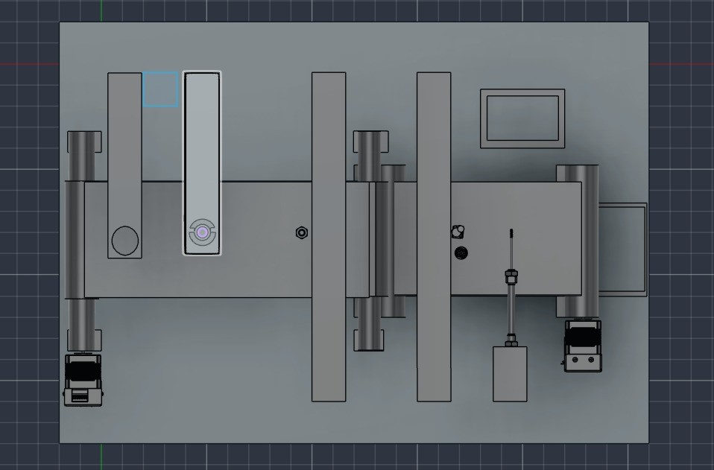
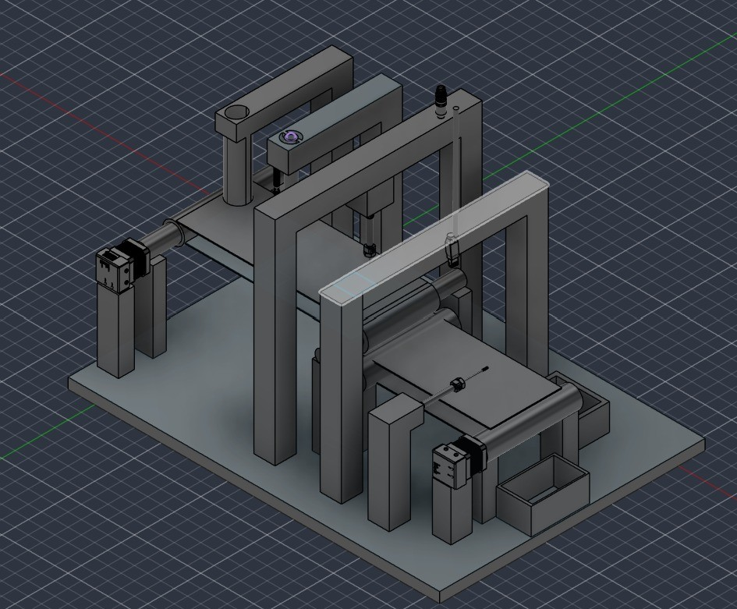
CAD Design: 3D Renders
TEAM CIPHER CORE | SREC
Camera arch and bins
Top view: conveyor and feeders
Key Mechanical Features
Feeders: stacked magazines with gate release drop base and top parts one by one.
C-bend: passive 180° gravity flip exposes the labelled side.
Vision arch: adjustable bracket holds the Pi Camera and LED lighting.
Sorting: diverter cylinder pushes NOT-OK parts into the reject bin.
Figure: Isometric view of the complete assembly line
8 / 18
Notes:
Show the isometric model first, then the camera-arch view and the top view. Call out the feeders, C-bend, vision arch and reject bin.

Slide 9
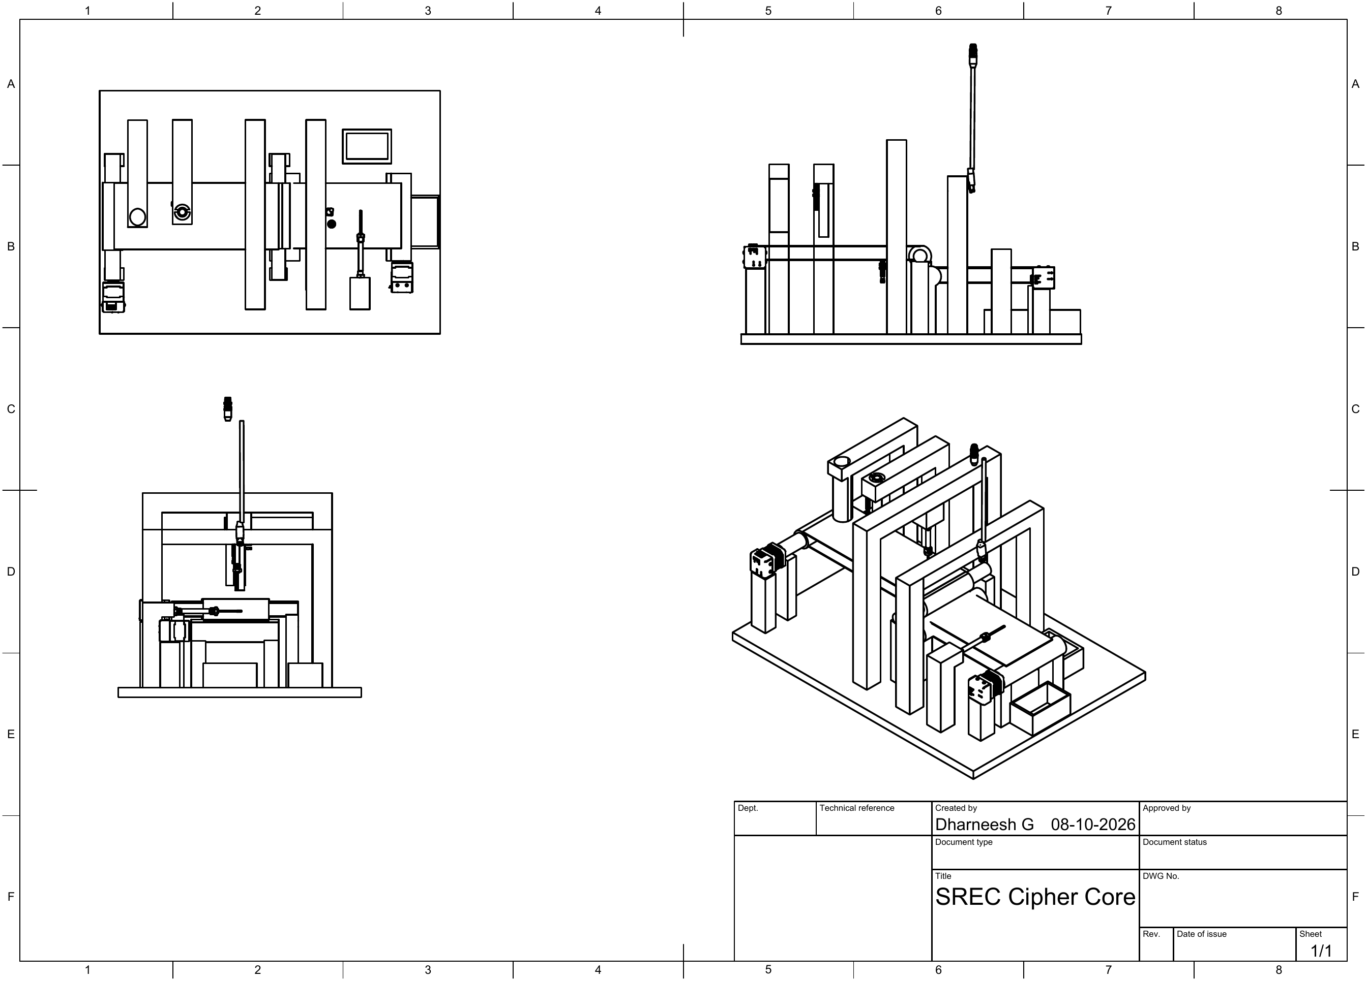
2D Engineering Drawing & Mechanical Specs
Materials & Mechanical Specs
Frame: T-slot aluminium extrusion – rigid, light, re-configurable without welding.
Fastening: T-nuts and corner brackets hold cylinders and sensors steady under repeated pressing.
C-bend: passive gravity track – no motor, no energy.
Camera mount: articulating brackets for focus and shadow control.
Structural check: loads are light (plastic caps, 25 mm cylinders); FEA of the press mount is planned in fabrication.
Figure: CAD 2D Diagram of the proposed system
9 / 18
Notes:
The A3 drawing gives the orthographic and isometric views. Right-hand panel explains material and mounting choices.

Slide 10
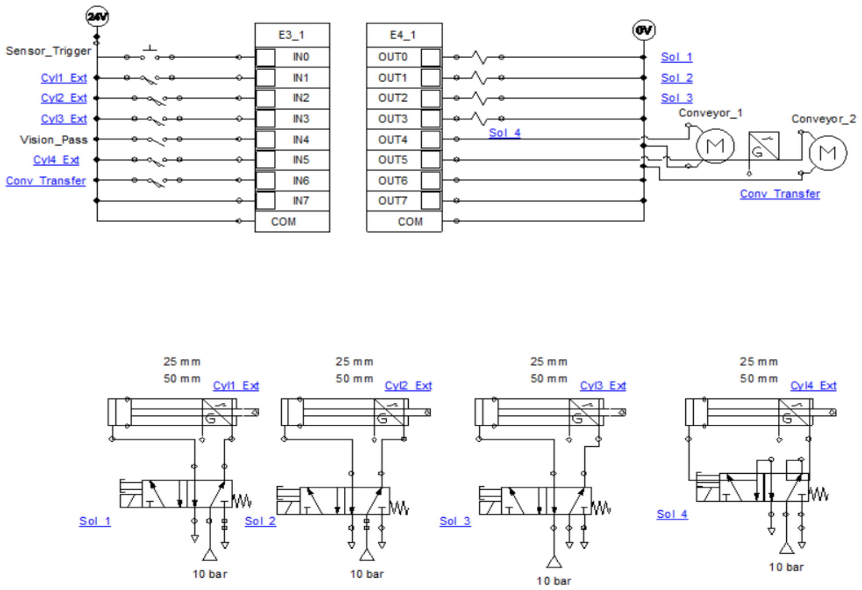
Electro-Pneumatic Circuit
TEAM CIPHER CORE | SREC
Circuit Notes
Inputs (24 V): start trigger, four cylinder-extended sensors, Vision_Pass and conveyor transfer sensor.
Outputs: four solenoid coils (Sol 1–4) and the conveyor drives.
Pneumatics: 4 double-acting cylinders on 5/2 valves, 10 bar supply.
Digital twin: logic validated virtually before the hardware build.
Figure: PLC I/O wiring and four cylinder circuits modelled in Automation Studio
10 / 18
Notes:
This is the digital twin: four cylinders with 5/2 valves, PLC inputs and outputs. The logic was validated virtually before building hardware.

Slide 11
Itemized Bill of Materials
Component | Specification | Qty | Sourcing
PLC | Delta PLC, 24 V DC I/O, WPLSoft programmable | 1 | Local industrial supplier
Edge computer | Raspberry Pi 4 | 1 | Local / authorised reseller
Camera & lighting | Pi Camera Module (CSI) + white LED module on articulating bracket | 1 | Local / electronics market
Pneumatic cylinders | Double-acting, 25 mm × 50 mm (press, diverter, feeder gates) | 4 | Local pneumatics supplier
Valves & manifold | 5/2-way 24 V DC solenoid valves on a central manifold block | 4 | Local pneumatics supplier
Conveyor | Linear transport with two drive motors | 1 set | Local fabrication
Sensors & isolation | Optical sensors for feeders and trigger; optocoupler boards 3.3 V to 24 V | 1 set | Local industrial / electronics
Frame & cabinet | T-slot extrusion, T-nuts, DIN rails, relays, 24 V supply, PVC ducts | 1 lot | Local suppliers
Procurement: all items are standard, off-the-shelf parts sourced locally – no imported specialty components.
12 / 18
Notes:
Everything is a standard industrial part. Quantities come from the Automation Studio model and the mechanical design.

Slide 12
Maker Journey: Stage 1 to Stage 2
Engineering Progress
Design evidence
Stage 1: defined the 5-station cell, feeders, vision approach and segregation.
3D CAD: full assembly modelled – isometric, top, feeder and camera views.
2D drawing: A3 sheet issued 08-10-2026.
Digital twin: 4-cylinder circuit built and simulated in Automation Studio.
PLC: ladder program written in Delta WPLSoft.
Vision: OpenCV approach set – image subtraction + edge detection on Pi 4.
Pneumatic and PLC Connection Circuits
2D CAD drawing
13 / 18
Notes:
Summarise what changed between stages: complete CAD, the digital twin, PLC logic and a defined vision approach. Mention the team and the repository link.

Slide 13
Safety & Hazard Mitigation
Failure Mode | Potential Hazard | Embedded Fail-Safe / Mitigation
Fault while press is active | Crush hazard at the pneumatic press | Hardwired NC loops instantly drop the output coils, de-energising the press safely.
Vision false accept / reject | Defective part passes or good part scrapped | Adjustable LED lighting removes shadows; golden-reference subtraction; one OK / NOT OK result to the PLC.
3.3 V GPIO meets 24 V logic | Damaged Pi, noisy or false signals | Optocoupler isolation boards; 3.3 V data and 24 V power routed in separate ducts.
Cylinder jam or air loss | Part mis-pressed or mis-sorted | Cylinder-extended sensors (Cyl 1–4) confirm each stroke before the PLC advances.
Feeder empty or jammed | Starved line, empty press cycles | Optical sensors confirm parts on each stack before release.
Physical Fail-Safes
Standards Considered
Emergency-stop and machine guarding
Sensor interlocks on every actuator stroke
Hardwired NC fail safe loops
ISO 4414 – pneumatic fluid power safety
IEC 60204-1 – electrical equipment of machines
ISO 12100 – machinery risk assessment
14 / 18
Notes:
Lead with the hardwired NC fail-safe: any fault drops the output coils and de-energises the press. The FMEA covers the five most likely failures.

Slide 14
Roadmap: 4-Month Fabrication Plan
Completed in Stage 2: 3D CAD and 2D drawing · Automation Studio digital twin · PLC ladder logic
1
2
3
4
MONTH 1
MONTH 2
MONTH 3
MONTH 4
Vision Pipeline
Mechanical Build
Pneumatics & PLC
Integration & Test
Set up Pi 4 and camera
OpenCV: LEO text, smudge, scratch, air-gap checks
Order frame, cylinders and valves
Assemble T-slot frame
Install conveyor, feeders and C-bend
Mount adjustable camera arch
Mount cylinders; pipe 5/2 valves to manifold
Wire optocouplers and ducts
Load ladder logic; integrate Pi
End-to-end cycle validation
Tune cycle time and diverter timing
Benchmark detection and rejection
Stage 3 target: a fully working prototype of feed, press, flip, inspect and sort ready for a live functional demonstration.
15 / 18
Notes:
Design work is already done. The four months cover vision, mechanical build, pneumatics and PLC, then integrated testing leading to the Stage 3 demo.

Slide 15
Technical Challenges & Risks
1
Low-contrast defects on translucent parts
2
3.3 V vision vs 24 V industrial logic
A clear base cap and white label make smudges, hairline air gaps and scratches hard to see. Reflections and shadows can cause false results.
Raspberry Pi GPIO cannot drive PLC inputs directly. A wrong interface risks damaging the Pi or creating noisy, false triggers.
3
On-the-fly rejection timing
4
Passive flip and feeding consistency
The diverter must fire exactly as a flagged part passes, with the conveyor still running and no dwell time to correct a late decision.
The gravity C-bend must flip every part exactly 180° and the feeders must release one part at a time without jams or double feeds.
16 / 18
Notes:
These are the four anticipated bottlenecks from the design stage; the next slide gives the matching mitigations.

Slide 16
Potential Solutions & Risk Mitigation
Risk | Primary solution | Backup / fallback
Low-contrast defects | Adjustable white LED lighting and shadow control; golden reference image subtraction plus edge detection; thresholds tuned in Phase 1. | Switch to back-lighting or low-angle lighting; add a second inspection angle.
3.3 V / 24 V interface | Optocoupler isolation boards between Pi GPIO and PLC inputs; data and power in separate ducts. | Swap in a relay interface board.
Rejection timing | Sensor-triggered tracking with a PLC timer delay between inspection and diverter, tuned during cell testing. | Reduce conveyor speed or add a second trigger sensor.
Flip and feed consistency | Adjustable C-bend geometry and press fixtures; optical sensors confirm each stack before release. | Add guide rails or a small pneumatic assist at the bend.
Design principle: modular subsystems – lighting, interface and bend can each be changed without redesigning the whole cell.
17 / 18
Notes:
Every risk has a primary fix and a backup. The modular design means any subsystem can be swapped without redesigning the cell.

Slide 17
References & Sources
Reference | Used for | Source
OpenCV documentation | Image subtraction and edge-detection pipeline | docs.opencv.org
Raspberry Pi documentation | Raspberry Pi 4 and Camera Module (CSI) interfacing | raspberrypi.com/documentation
Delta PLC and WPLSoft | Ladder programming | deltaww.com
Automation Studio | Electro-pneumatic circuit simulation | Famic Technologies
ISO 4414 | Pneumatic fluid power safety rules | iso.org
IEC 60204-1 | Electrical equipment of machines | iec.ch
Image sources: All photographs, CAD renders, engineering drawings, circuit and ladder screenshots in this deck are original work of Team Cipher Core, Sri Ramakrishna Engineering College.
18 / 18
Notes:
Tools, documentation and standards used. All images are the team’s own work.

